Slide 1
Graphs
It’s all about relationships
Terence Parr
MSDS program University of San Francisco

Slide 2
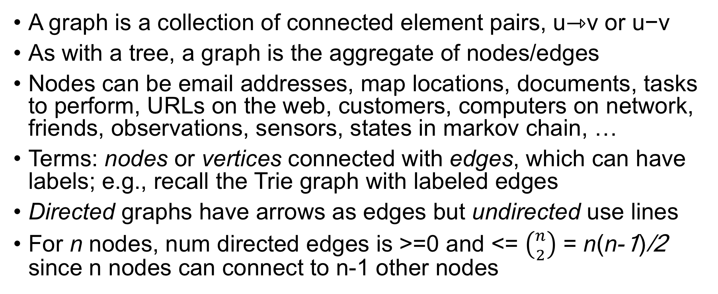
What’s a graph?
A graph is a collection of connected element pairs, u⇾v or u−v
As with a tree, a graph is the aggregate of nodes/edges
Nodes can be email addresses, map locations, documents, tasks to perform, URLs on the web, customers, computers on network, friends, observations, sensors, states in markov chain, …
Terms: nodes or vertices connected with edges, which can have labels; e.g., recall the Trie graph with labeled edges
Directed graphs have arrows as edges but undirected use lines
For n nodes, num directed edges is >=0 and <= $\left({n \atop 2}\right)$ = n(n-1)/2 since n nodes can connect to n-1 other nodes

Slide 3
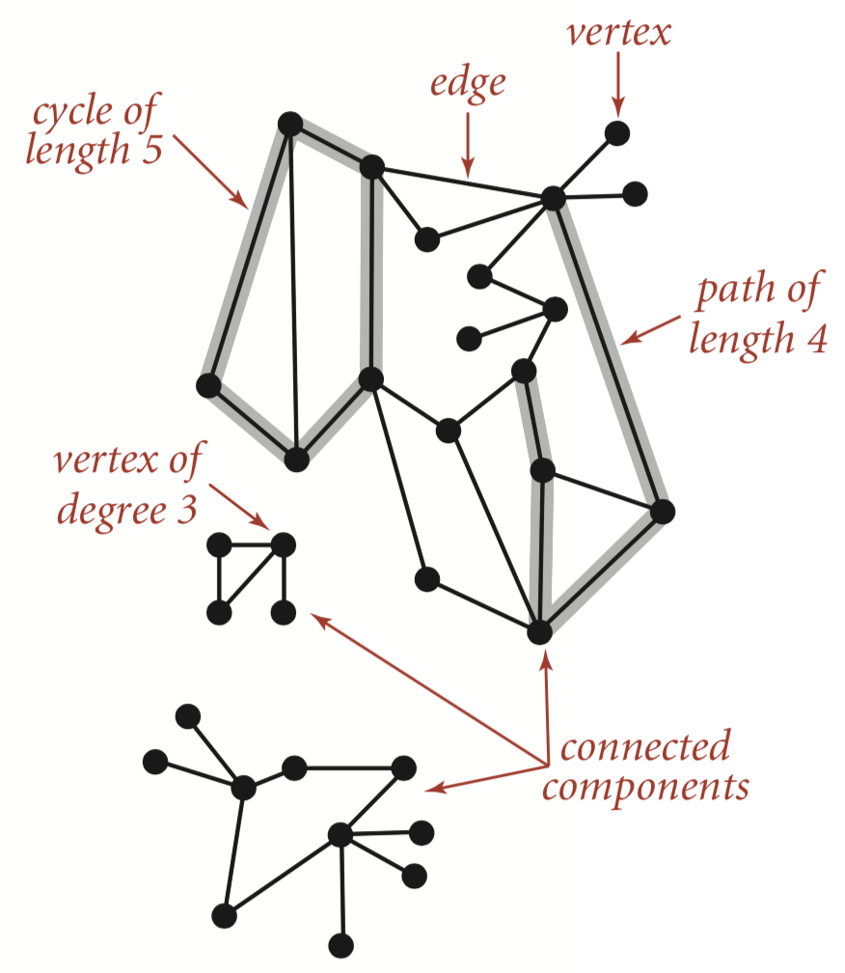
Undirected graph, terms
From: Algorithms book by Robert Sedgewick and Kevin Wayne

Slide 4
Facebook friend network, different layouts

Slide 5
Common questions
Is q reachable from p?
How many edges are on paths between p and q?
Is graph connected? (reach any p from any q)
Is graph cyclic? (p reaches p traversing at least one edge)
Which nodes are within k edges of node p? (neighborhood)
What is shortest path (num edges) from p to q?
What is shortest path using edge weights? [beyond scope of 689]
Traveling salesman problem [beyond scope of 689]

Slide 6
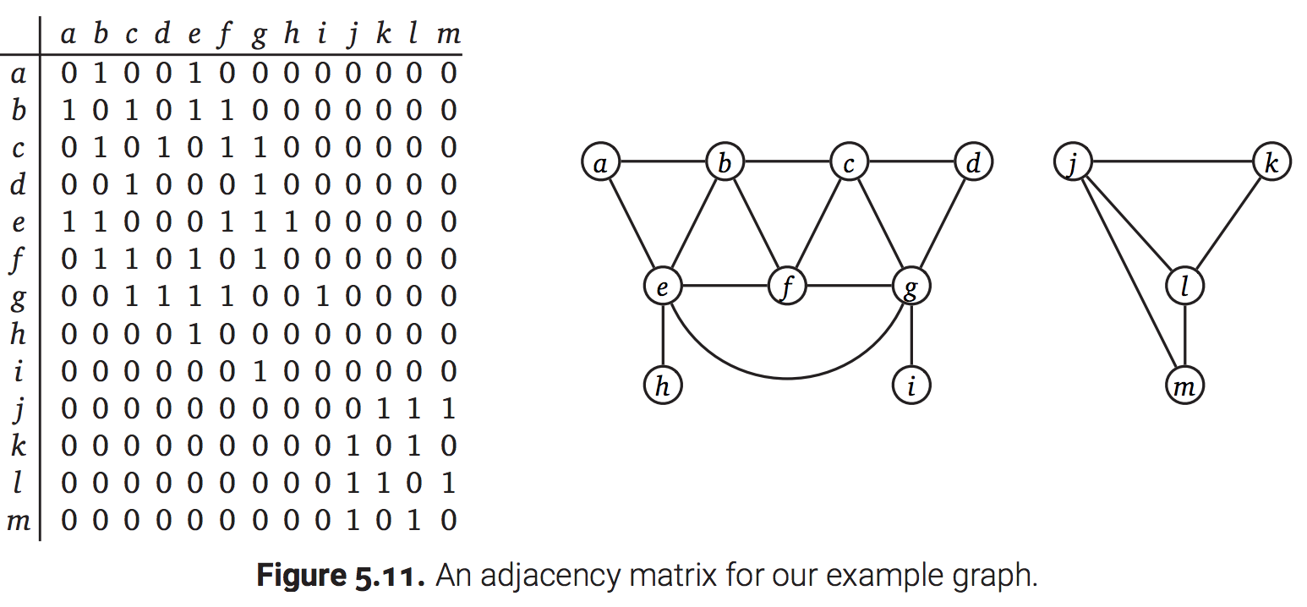
Adjacency matrix implementations
Adjacency matrix, n x n matrix of {0,1} if unlabeled or {labels} if edges are labeled; undirected matrices are symmetric
Wastes space for sparse edges; use sparse matrix
Fast to access arbitrary node’s edges
http://jeffe.cs.illinois.edu/teaching/algorithms/book/05-graphs.pdf

Slide 7
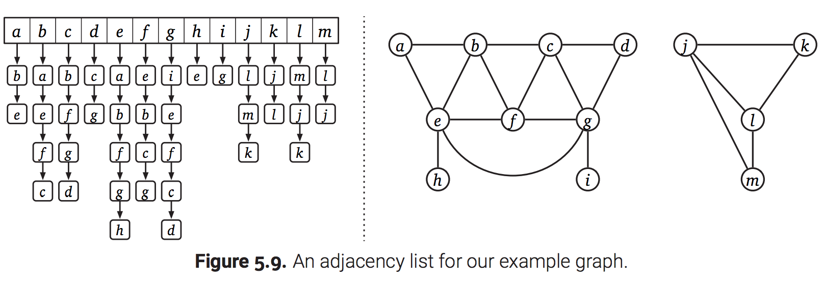
Adjacency list implementations
List of edge lists for nodes
Fast arbitrary node access for numbered nodes, space efficient
http://jeffe.cs.illinois.edu/teaching/algorithms/book/05-graphs.pdf

Slide 8
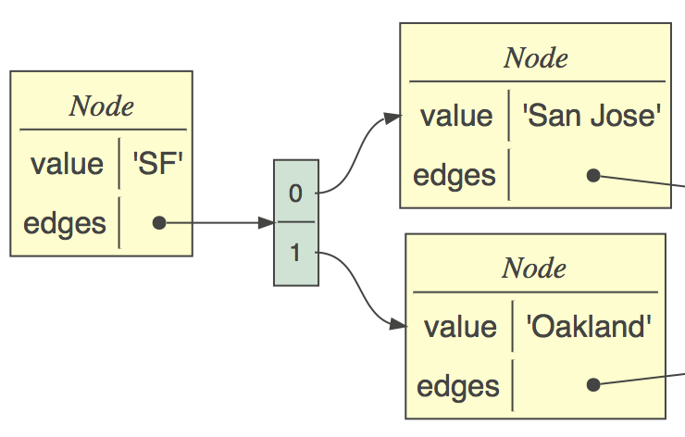
Connected nodes implementation
Common implementation due to nice mapping to objects
Each node has info about node and edge list
Use list or dictionary index if you need to access nodes directly
class Node:
def __init__(self, value):
self.value = value
self.edges = []
def edge(self, target:Node):
self.edges.append(target)

Slide 9
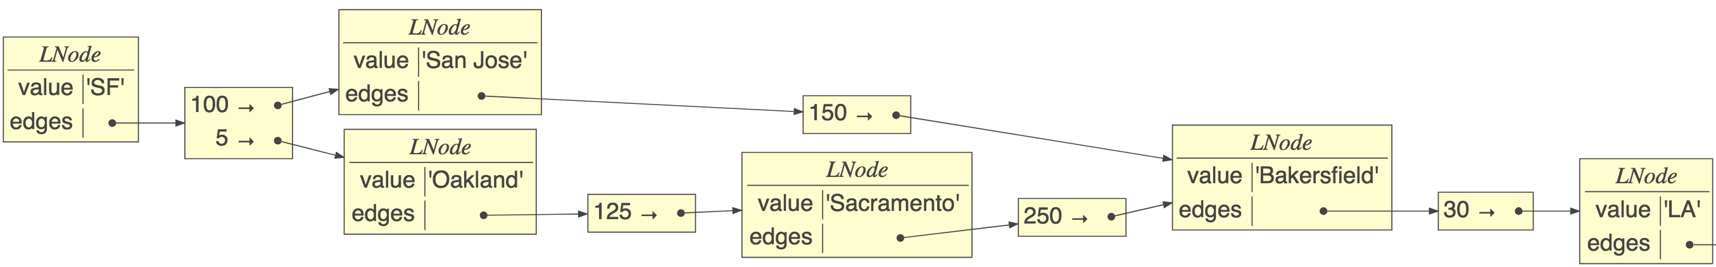
Implementation with labels
class LNode:
def __init__(self, value):
self.value = value
self.edges = {}
def edge(self, label, target):
self.edges[label] = target
Edge->node dictionary, not list
sf.edge(100,sj)
sj.edge(150,baker)
…

Slide 10
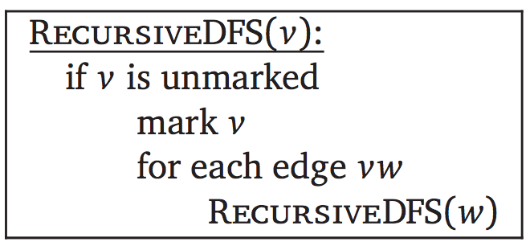
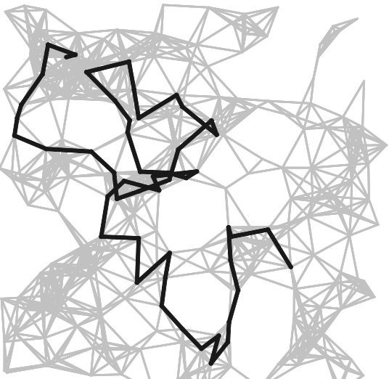
Depth-first search (review)
The fundamental algorithm for answering graph questions
Visits all reachable nodes from p, avoiding cycles
Go deep first
def walk_graph(p:Node, visited=set()):
if p in visited: return
visited.add(p)
for q in p.edges:
walk_graph(q, visited)
Algorithms book by Sedgewick, Wayne
O(n,m) = n + m, for n nodes, m edges; m can be n^2

Slide 11
Is there a cycle from p to p?
E.g., can I get back to start via one-way streets?
If we run into starting node in visited set, return True; blue means different than plain walk
def iscyclic(p:Node) -> bool:
return iscyclic_(p,p,set())
def iscyclic_(start:Node, p:Node, visited) -> bool:
if p in visited:
if p is start: return True # we find start?
return False # can't loop forever so stop
visited.add(p)
for q in p.edges:
c = iscyclic_(start, q, visited)
if c: return True # found it, we can stop
return False

Slide 12
Find set of nodes p can reach
https://github.com/parrt/msds689/blob/master/notes/graphs.ipynb
E.g., can we reach city y from city x (hint: Juneau not accessible)?
Need two sets, one for avoiding cycles, another for reached nodes
If we used visited for both, then p would also appear to reach itself, which might not be true; we add start node to visited but doesn't mean we can reach start via any path in graph
def reachable(p:Node) -> set:
reaches = set();
reachable_(p, reaches, set())
return reaches
def reachable_(p:Node, reaches:set, visited:set):
if p in visited: return
visited.add(p)
for q in p.edges:
reaches.add(q) # add only if we traverse
reachable_(q, reaches, visited)

Slide 13
Find set of nodes p can reach, track depth
E.g., how many hops from person A to B on social network?
Track node->depth map, not just set of nodes
def reachable(p:Node) -> dict:
reaches = dict()
reachable_(p, reaches, set(), depth=0)
return reaches
def reachable_(p:Node, reaches:dict, visited:set, depth:int):
if p in visited: return
visited.add(p)
reaches[p] = depth # distance to p from start (could be 0)
for q in p.edges:
reachable_(q, reaches, visited, depth+1)
https://github.com/parrt/msds689/blob/master/notes/graphs.ipynb

Slide 14
Find neighborhood within k edges
E.g., find all friends within k friend hops
Track dict node->depth, stop when we reach depth
def neighbors(p:Node, k:int) -> dict:
reaches = dict()
neighbors_(p, k, reaches, set(), depth=0)
return reaches
def neighbors_(p:Node, k:int, reaches:dict, visited:set, depth:int):
if p in visited or depth>k: return # terminate at depth
visited.add(p)
reaches[p] = depth
for q in p.edges:
neighbors_(q, k, reaches, visited, depth+1)

Slide 15
Find first path from p to q
def path(p:Node, q:Node) -> list:
return path_(p, q, [p], set())
def path_(p:Node, q:Node, path:list, visited:set):
if p is q: return path # found q!
if p in visited: return None # avoid cycle
visited.add(p)
for t in p.edges:
pa = path_(t, q, path+[t], visited)
if pa is not None: return pa
return None
recursion tree
Must track path not set of nodes
https://github.com/parrt/msds689/blob/master/notes/graphs.ipynb

Slide 16
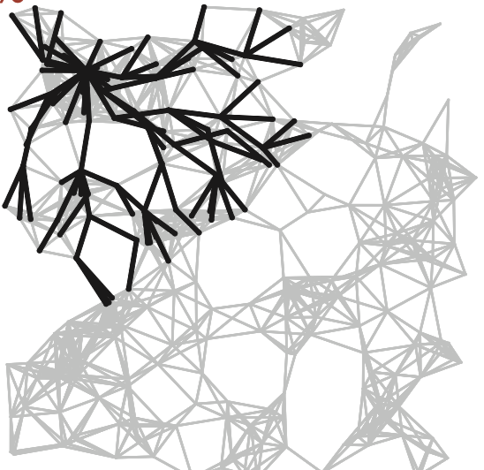
Breadth-first search vs DFS
Visit all children then grandchildren…
Algorithms book by Sedgewick, Wayne

Slide 17
BFS implementation
Maintains work list of nodes and visited set
BFS DFS Visit A Visit A Visit B Visit B Visit D Visit C Visit C Visit D Visit E Visit E
Add to work list end, pull from front (queue)
Nonrecursive
def BFS(root:LNode):
visited = {root}
worklist = [root]
while len(worklist)>0:
p = worklist.pop(0) # dequeue
print(f“Visit {p}”)
for q in p.edges:
if q not in visited:
worklist.append(q)
visited.add(q)
https://github.com/parrt/msds689/blob/master/notes/graphs.ipynb

Slide 18
Find shortest path from p to q?
BFS where work list is a list of paths not list of nodes
Tail of path is where we left off work on it
By searching all children before going deeper, we auto- magically find paths with shortest lengths
def shortest(root:Node, target:Node):
visited = {root}
worklist = [[root]] # list of paths
while len(worklist)>0:
path = worklist.pop(0)
p = path[-1] # tail of path
if p is target: return path
for q in p.edges:
if q not in visited:
worklist.append(path+[q])
visited.add(q)
https://github.com/parrt/msds689/blob/master/notes/graphs.ipynb

Slide 19
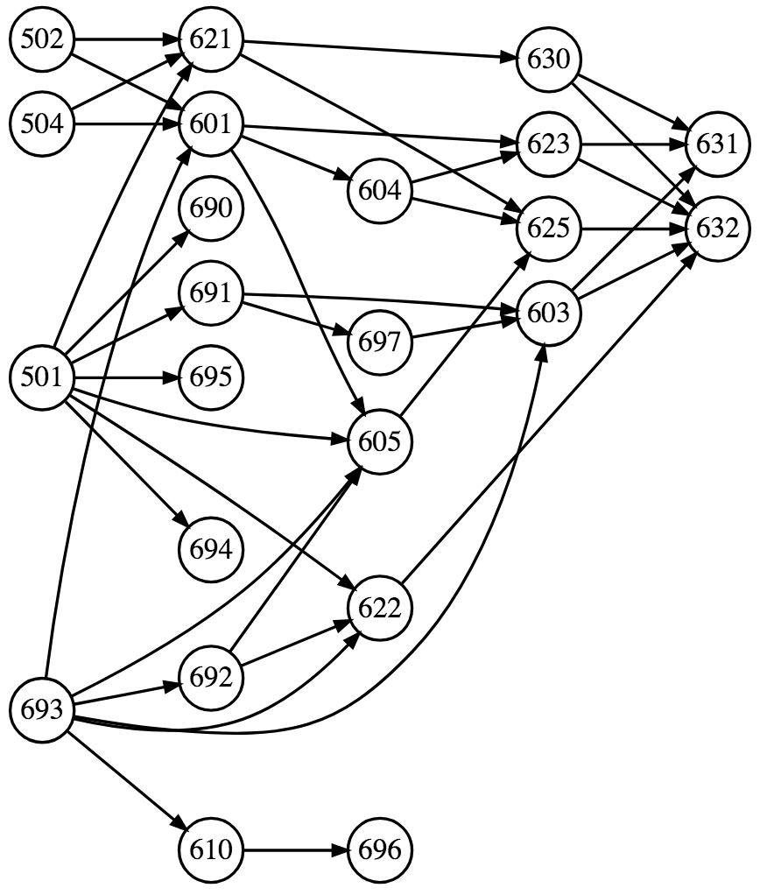
Topological sort (acyclic graphs)
Problem: Find linear ordering of nodes in directed acyclic graph such that all constraints, u->v, are satisfied where u depends on v so v must come before u OR u->v mean u precedes v
Examples: task ordering or course prereq chain.
E.g., 502 is prereq for 621 and 601… Find order we should take classes
Sort is not usually unique
Cycles are meaningless for dependencies; how can 630-01 be attended before itself?

Slide 20
Example topological sort u depends v
If u depends on v, any linear ordering where edges point to left is solution

Slide 21
Example where u precedes v
In this case, edges must point to the right

Slide 22
How to approach the problem
What order should we do these tasks (u depends v)? Think in terms of traversal order
What if we add party goal?

Slide 23
DFS-based topo sort implementation
Lots of very complex algorithms on the web (not sure why)
Simplest solution: DFS-based topological sort
A valid sort is just the post-order graph traversal if u depends v!
If u precedes v, reverse the result of post-order traversal; See proof page 582 of Sedgewick/Wayne Algorithms book
Well, we have to make sure to do DFS on all root nodes (nodes w/o incoming edges) but core is just DFS
With one root, it’s just postorder traversal via DFS

Slide 24
Example walk through
DFS starting with party: party -> 628 -> 630 back out then hit 689 then lunch back out and hit seminar
Postorder traversal processes/prints after visiting children: 630, lunch, seminar, 689, 628, party
Solution: 630-01, lunch, seminar, 689-02, 628 hw, party
https://github.com/parrt/msds689/blob/master/notes/graphs.ipynb

Slide 25
DFS postorder traversal
def postorder(p:Node, sorted:list, visited:set):
if p in visited: return
visited.add(p)
for q in p.edges:
postorder(q, sorted, visited)
sorted.append(p) # postorder done after kids

Slide 26
With multiple roots, hit them all
MSDS = """501->690
502,504,693->601
601->604
601,604->623
…"""
# nodes is dict edge list mapping from->to
def toposort(nodes:dict):
sorted = []
visited = set()
while len(visited) < len(nodes):
todo = [node for node in nodes.values()
if node not in visited]
if len(todo)>0:
postorder(todo[0], sorted, visited)
return reverse(sorted)
We reverse postorder here since u precedes v

Slide 27
Summary
Graphs are for showing relationships between elements
DFS for finding a path or multiple paths or cycles (recursive backtracking to find all nodes)
BFS for find shortest (in edges) path or neighborhood
DFS postorder great for topo sort
Recursive alg’s all use visited set to avoid cycles
Non-recursive DFS: (use work list stack)
push targets in reverse order onto work list
pop last work list item for next node to process
Non-recursive BFS: (use work list queue)
push targets in order onto work list
pull from first position

Slide 28
Sample graph problems

Slide 29
Exercise
Given a directed graph, detect all direct or indirect cycles
For p in nodes: report iscyclic(p)

Slide 30
Exercise
Given 2 lists P,Q and function conn(p,q)=true if edge p->q exists. P is origin (starting) nodes and Q destination nodes. Report True for P[i] reaches Q[i] directly or indirectly
E.g., P, Q could be cities and conn(p,q)=true if direct flight p->q
Create graph using conn(p,q) for all nodes in P and Q
For each P[i], see if Q[i] is in reaches(P[i]) set.

Slide 31
Exercise: Boggle
Given m x n matrix of letters. Find all English words possible by taking one adjacent step to another letter, starting with any letter; one occurrence of each letter per word; you’re given a dictionary (/usr/share/dict/words)
For each node in graph, find all words
For a specific starting node p, perform DFS; at each node q, look up word consisting of all letters on path from p to q, checking for duplicated letters

Slide 32
Exercise: Find all words with given prefix
Find words beginning with "ap"
See https://github.com/parrt/msds689/blob/master/notes/code/prefix_trie.py

Slide 33
Exercise: Find all words with given prefix
Find words beginning with "ap"
See https://github.com/parrt/msds689/blob/master/notes/code/prefix_trie.py

Slide 34
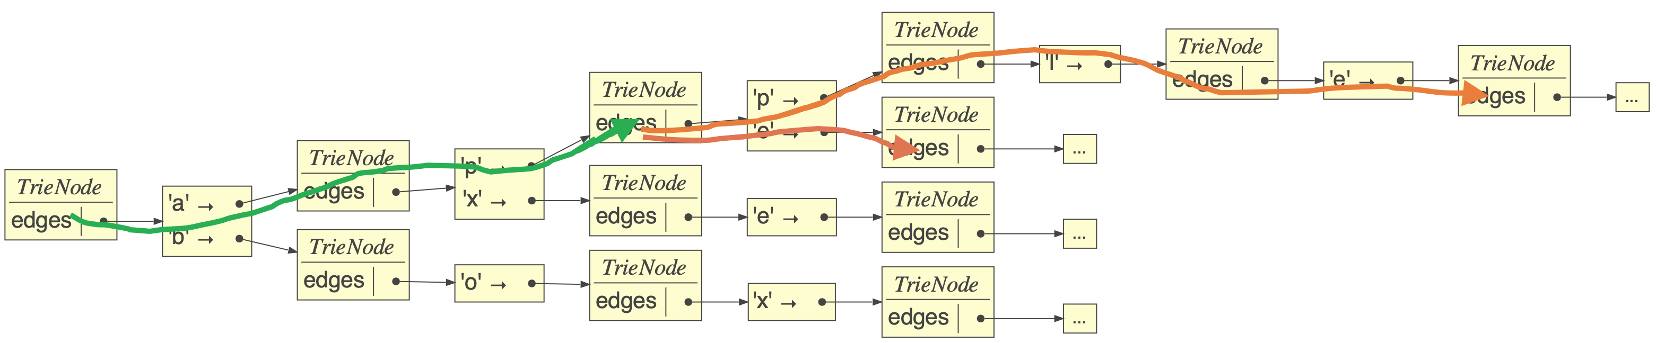
Exercise: Find all words with given prefix
Build a Trie with dictionary words
Find node in trie reached by prefix; call it p (green line)
Recursively, using depth first search, find all reachable leaf (stop/accept) nodes (orange lines)
Pass a path string as arg down the recursion chain to incrementally build strings reachable from p def suffixes_(p:TrieNode, path, paths): …
There can be no cycle so we don't worry about "visited" arg, just track the current path and the overall list of paths we found
See https://github.com/parrt/msds689/blob/master/notes/code/prefix_trie.py

Slide 35
Coding exercise: Visualize: FB friend graph with networkx
pip install networkx
download and uncompress https://snap.stanford.edu/data/facebook_combined.txt.gz
Get small sample of edges then do edge_subgraph(), draw_networkx_edges(), draw_networkx_nodes()
Need to pass positions of nodes for layout, such as circular_layout()
See https://github.com/parrt/msds689/blob/master/notes/code/viz_facebook.py

Slide 36
Coding exercise networkx: distances from SF to other cities
Download data: https://github.com/parrt/msds689/blob/master/notes/code/distances.csv
Create graph showing SF to other cities using multiple layouts
See https://github.com/parrt/msds689/blob/master/notes/code/sfo_city_distances.py

